Slide 1
Chapter 3 outline
3.1 transport-layer services
3.2 multiplexing and demultiplexing
3.3 connectionless transport: UDP
3.4 principles of reliable data transfer
3.5 connection-oriented transport: TCP
  segment structure
  reliable data transfer
  flow control
  connection management
3.6 principles of congestion control
3.7 TCP congestion control

Slide 2
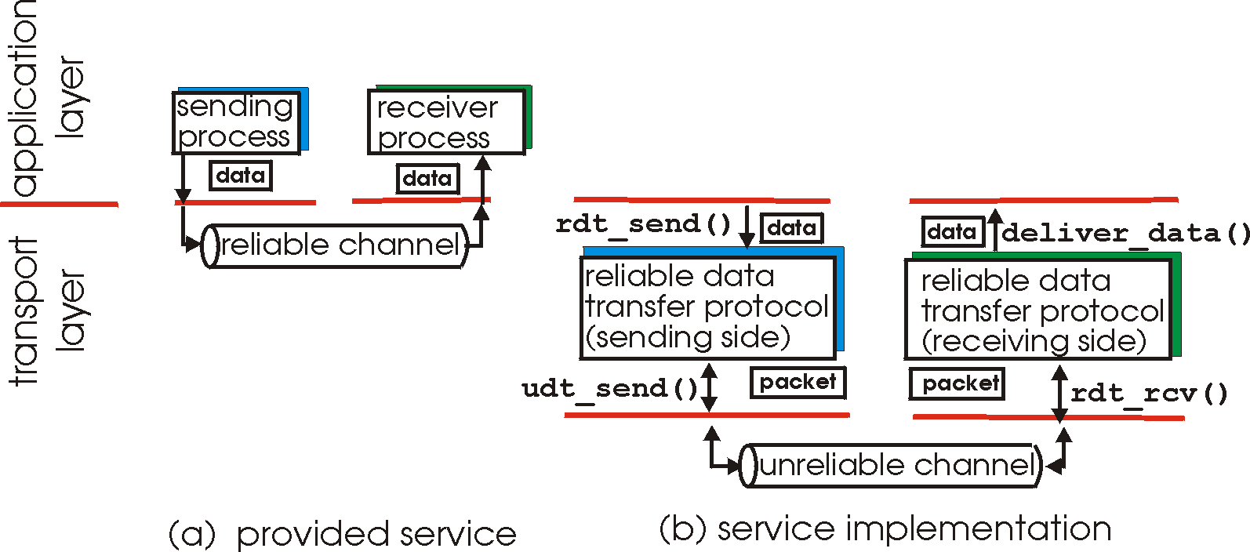
Principles of reliable data transfer
important in application, transport, link layers
  top-10 list of important networking topics!
characteristics of unreliable channel will determine complexity of reliable data transfer protocol (rdt)

Slide 3
Principles of reliable data transfer
important in application, transport, link layers
  top-10 list of important networking topics!
characteristics of unreliable channel will determine complexity of reliable data transfer protocol (rdt)

Slide 4
Principles of reliable data transfer
important in application, transport, link layers
  top-10 list of important networking topics!
characteristics of unreliable channel will determine complexity of reliable data transfer protocol (rdt)

Slide 5
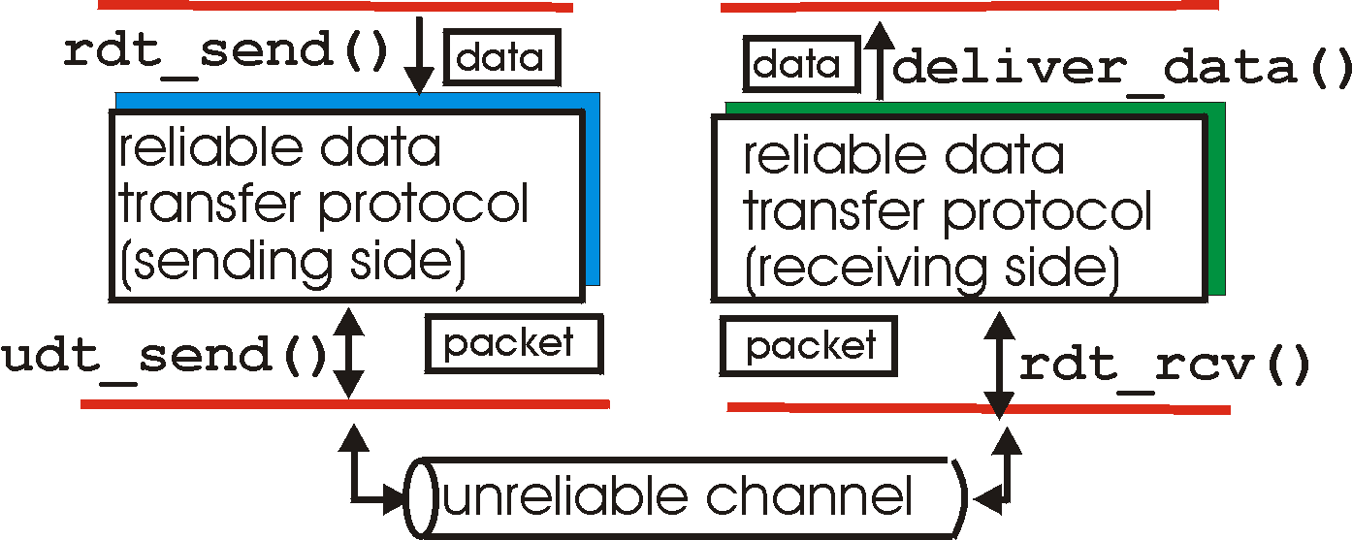
Reliable data transfer: getting started
rdt_send(): called from above, (e.g., by app.). Passed data to
deliver to receiver upper layer
deliver_data(): called by rdt to deliver data to upper
send
side
receive
side
udt_send(): called by rdt,
to transfer packet over
unreliable channel to receiver
rdt_rcv(): called when packet arrives on rcv-side of channel

Slide 6
Reliable data transfer: getting started
we’ll:
incrementally develop sender, receiver sides of reliable data transfer protocol (rdt)
consider only unidirectional data transfer
  but control info will flow on both directions!
use finite state machines (FSM) to specify sender, receiver
event causing state transition
actions taken on state transition
state: when in this “state” next state uniquely determined by next event
state
1
state
2
event
actions

Slide 7
rdt1.0: reliable transfer over a reliable channel
underlying channel perfectly reliable
  no bit errors
  no loss of packets
separate FSMs for sender, receiver:
  sender sends data into underlying channel
  receiver reads data from underlying channel
Wait for call from above
rdt_send(data)
Wait for call from below
rdt_rcv(packet)
extract (packet,data)
deliver_data(data)
packet = make_pkt(data)
udt_send(packet)
sender
receiver

Slide 8
rdt2.0: channel with bit errors
underlying channel may flip bits in packet
  checksum to detect bit errors
the question: how to recover from errors:
  acknowledgements (ACKs): receiver explicitly tells sender that pkt received OK
  negative acknowledgements (NAKs): receiver explicitly tells sender that pkt had errors
  sender retransmits pkt on receipt of NAK
new mechanisms in rdt2.0 (beyond rdt1.0):
  error detection
  receiver feedback: control msgs (ACK,NAK) rcvr->sender
How do humans recover from “errors”
during conversation?

Slide 9
rdt2.0: channel with bit errors
underlying channel may flip bits in packet
  checksum to detect bit errors
the question: how to recover from errors:
  acknowledgements (ACKs): receiver explicitly tells sender that pkt received OK
  negative acknowledgements (NAKs): receiver explicitly tells sender that pkt had errors
  sender retransmits pkt on receipt of NAK
new mechanisms in rdt2.0 (beyond rdt1.0):
  error detection
  feedback: control msgs (ACK,NAK) from receiver to sender

Slide 10
rdt2.0: FSM specification
rdt_send(data)
sndpkt = make_pkt(data, checksum)
udt_send(sndpkt)
receiver
rdt_rcv(rcvpkt) &&
isNAK(rcvpkt)
Wait for call from above
Wait for ACK or NAK
rdt_rcv(rcvpkt) &&
corrupt(rcvpkt)
udt_send(sndpkt)
udt_send(NAK)
rdt_rcv(rcvpkt) && isACK(rcvpkt)
Λ
Wait for call from below
sender
rdt_rcv(rcvpkt) &&
notcorrupt(rcvpkt)
extract(rcvpkt,data)
deliver_data(data)
udt_send(ACK)

Slide 11
rdt2.0: operation with no errors
rdt_send(data)
snkpkt = make_pkt(data, checksum)
udt_send(sndpkt)
rdt_rcv(rcvpkt) &&
isNAK(rcvpkt)
Wait for call from above
Wait for ACK or NAK
rdt_rcv(rcvpkt) &&
corrupt(rcvpkt)
udt_send(sndpkt)
udt_send(NAK)
rdt_rcv(rcvpkt) && isACK(rcvpkt)
Wait for call from below
Λ
rdt_rcv(rcvpkt) &&
notcorrupt(rcvpkt)
extract(rcvpkt,data)
deliver_data(data)
udt_send(ACK)

Slide 12
rdt2.0: error scenario
rdt_send(data)
snkpkt = make_pkt(data, checksum)
udt_send(sndpkt)
rdt_rcv(rcvpkt) &&
isNAK(rcvpkt)
Wait for call from above
Wait for ACK or NAK
rdt_rcv(rcvpkt) &&
corrupt(rcvpkt)
udt_send(sndpkt)
udt_send(NAK)
rdt_rcv(rcvpkt) && isACK(rcvpkt)
Wait for call from below
Λ
rdt_rcv(rcvpkt) &&
notcorrupt(rcvpkt)
extract(rcvpkt,data)
deliver_data(data)
udt_send(ACK)

Slide 13
rdt2.0 has a fatal flaw!
what happens if ACK/NAK corrupted?
sender doesn’t know what happened at receiver!
can’t just retransmit: possible duplicate
handling duplicates:
sender retransmits current pkt if ACK/NAK corrupted
sender adds sequence number to each pkt
receiver discards (doesn’t deliver up) duplicate pkt
stop and wait
sender sends one packet,
then waits for receiver
response

Slide 14
rdt2.1: sender, handles garbled ACK/NAKs
rdt_send(data)
sndpkt = make_pkt(0, data, checksum)
udt_send(sndpkt)
rdt_rcv(rcvpkt) &&
( corrupt(rcvpkt) ||
isNAK(rcvpkt) )
Wait for call 0 from above
Wait for ACK or NAK 0
udt_send(sndpkt)
rdt_rcv(rcvpkt)
&& notcorrupt(rcvpkt)
&& isACK(rcvpkt)
rdt_rcv(rcvpkt)
&& notcorrupt(rcvpkt)
&& isACK(rcvpkt)
Λ
Λ
Wait for ACK or NAK 1
Wait for
call 1 from above
rdt_rcv(rcvpkt) &&
( corrupt(rcvpkt) ||
isNAK(rcvpkt) )
rdt_send(data)
udt_send(sndpkt)
sndpkt = make_pkt(1, data, checksum)
udt_send(sndpkt)

Slide 15
rdt2.1: receiver, handles garbled ACK/NAKs
rdt_rcv(rcvpkt) && notcorrupt(rcvpkt)
&& has_seq0(rcvpkt)
extract(rcvpkt,data)
deliver_data(data)
sndpkt = make_pkt(ACK, chksum)
udt_send(sndpkt)
rdt_rcv(rcvpkt) && (corrupt(rcvpkt)
rdt_rcv(rcvpkt) && (corrupt(rcvpkt)
sndpkt = make_pkt(NAK, chksum)
udt_send(sndpkt)
sndpkt = make_pkt(NAK, chksum)
udt_send(sndpkt)
Wait for
0 from below
Wait for
1 from below
rdt_rcv(rcvpkt) &&
not corrupt(rcvpkt) &&
has_seq1(rcvpkt)
rdt_rcv(rcvpkt) &&
not corrupt(rcvpkt) &&
has_seq0(rcvpkt)
sndpkt = make_pkt(ACK, chksum)
udt_send(sndpkt)
sndpkt = make_pkt(ACK, chksum)
udt_send(sndpkt)
rdt_rcv(rcvpkt) && notcorrupt(rcvpkt)
&& has_seq1(rcvpkt)
extract(rcvpkt,data)
deliver_data(data)
sndpkt = make_pkt(ACK, chksum)
udt_send(sndpkt)

Slide 16
rdt2.1: discussion
sender:
seq # added to pkt
two seq. #’s (0,1) will suffice. Why?
must check if received ACK/NAK corrupted
twice as many states
  state must “remember” whether “expected” pkt should have seq # of 0 or 1
receiver:
must check if received packet is duplicate
  state indicates whether 0 or 1 is expected pkt seq #
note: receiver can not know if its last ACK/NAK received OK at sender

Slide 17
rdt2.2: a NAK-free protocol
same functionality as rdt2.1, using ACKs only
instead of NAK, receiver sends ACK for last pkt received OK
  receiver must explicitly include seq # of pkt being ACKed
duplicate ACK at sender results in same action as NAK: retransmit current pkt

Slide 18
rdt2.2: sender, receiver fragments
rdt_send(data)
sndpkt = make_pkt(0, data, checksum)
udt_send(sndpkt)
rdt_rcv(rcvpkt) &&
( corrupt(rcvpkt) ||
isACK(rcvpkt,1) )
Wait for call 0 from above
Wait for ACK
0
udt_send(sndpkt)
sender FSM
fragment
rdt_rcv(rcvpkt)
&& notcorrupt(rcvpkt)
&& isACK(rcvpkt,0)
rdt_rcv(rcvpkt) &&
(corrupt(rcvpkt) ||
has_seq1(rcvpkt))
Λ
Wait for
0 from below
receiver FSM
fragment
udt_send(sndpkt)
rdt_rcv(rcvpkt) && notcorrupt(rcvpkt)
&& has_seq1(rcvpkt)
extract(rcvpkt,data)
deliver_data(data)
sndpkt = make_pkt(ACK1, chksum)
udt_send(sndpkt)

Slide 19
rdt3.0: channels with errors and loss
new assumption: underlying channel can also lose packets (data, ACKs)
  checksum, seq. #, ACKs, retransmissions will be of help … but not enough
approach: sender waits “reasonable” amount of time for ACK
retransmits if no ACK received in this time
if pkt (or ACK) just delayed (not lost):
  retransmission will be duplicate, but seq. #’s already handles this
  receiver must specify seq # of pkt being ACKed
requires countdown timer

Slide 20
rdt3.0 sender
rdt_send(data)
rdt_rcv(rcvpkt) &&
( corrupt(rcvpkt) ||
isACK(rcvpkt,1) )
sndpkt = make_pkt(0, data, checksum)
udt_send(sndpkt)
start_timer
rdt_rcv(rcvpkt)
Λ
Λ
Wait for
call 0from above
Wait for ACK0
timeout
udt_send(sndpkt)
start_timer
rdt_rcv(rcvpkt)
&& notcorrupt(rcvpkt)
&& isACK(rcvpkt,1)
rdt_rcv(rcvpkt)
&& notcorrupt(rcvpkt)
&& isACK(rcvpkt,0)
stop_timer
stop_timer
Wait for ACK1
Wait for
call 1 from above
timeout
udt_send(sndpkt)
start_timer
rdt_rcv(rcvpkt)
rdt_send(data)
Λ
rdt_rcv(rcvpkt) &&
( corrupt(rcvpkt) ||
isACK(rcvpkt,0) )
sndpkt = make_pkt(1, data, checksum)
udt_send(sndpkt)
start_timer
Λ

Slide 21

rdt3.0 in action
sender
receiver
sender
receiver
send pkt0
pkt0
send pkt0
pkt0
rcv pkt0
rcv pkt0
ack0
send ack0
ack0
send ack0
rcv ack0
rcv ack0
send pkt1
pkt1
send pkt1
pkt1
rcv pkt1
X
ack1
send ack1
loss
rcv ack1
send pkt0
pkt0
rcv pkt0
timeout
resend pkt1
ack0
send ack0
pkt1
rcv pkt1
ack1
send ack1
rcv ack1
send pkt0
pkt0
(a) no loss
rcv pkt0
ack0
send ack0
(b) packet loss

Slide 22
rdt3.0 in action
sender
receiver
sender
receiver
send pkt0
pkt0
send pkt0
pkt0
rcv pkt0
rcv pkt0
ack0
send ack0
send ack0
rcv ack0
ack0
send pkt1
pkt1
rcv ack0
rcv pkt1
send pkt1
pkt1
send ack1
rcv pkt1
ack1
send ack1
ack1
X
loss
timeout
resend pkt1
pkt1
rcv pkt1
timeout
resend pkt1
rcv ack1
pkt1
rcv pkt1
pkt0
(detect duplicate)
send pkt0
send ack1
ack1
(detect duplicate)
ack1
rcv pkt0
rcv ack1
send ack1
rcv ack1
ack0
send ack0
pkt0
send pkt0
pkt0
send pkt0
rcv pkt0
rcv pkt0
ack0
(detect duplicate)
ack0
send ack0
send ack0
(c) ACK loss
(d) premature timeout/ delayed ACK

Slide 23
Performance of rdt3.0
rdt3.0 is correct, but performance stinks
e.g.: 1 Gbps link, 15 ms prop. delay, 8000 bit packet:
L
8000 bits
D_{trans} =
=
=
8 microsecs
R
10⁹ bits/sec
  U _{sender}: utilization – fraction of time sender busy sending
  if RTT=30 msec, 1KB pkt every 30 msec: 33kB/sec thruput over 1 Gbps link
network protocol limits use of physical resources!

Slide 24
rdt3.0: stop-and-wait operation
sender
receiver
first packet bit transmitted, t = 0
last packet bit transmitted, t = L / R
first packet bit arrives
RTT
last packet bit arrives, send ACK
ACK arrives, send next
packet, t = RTT + L / R

Slide 25
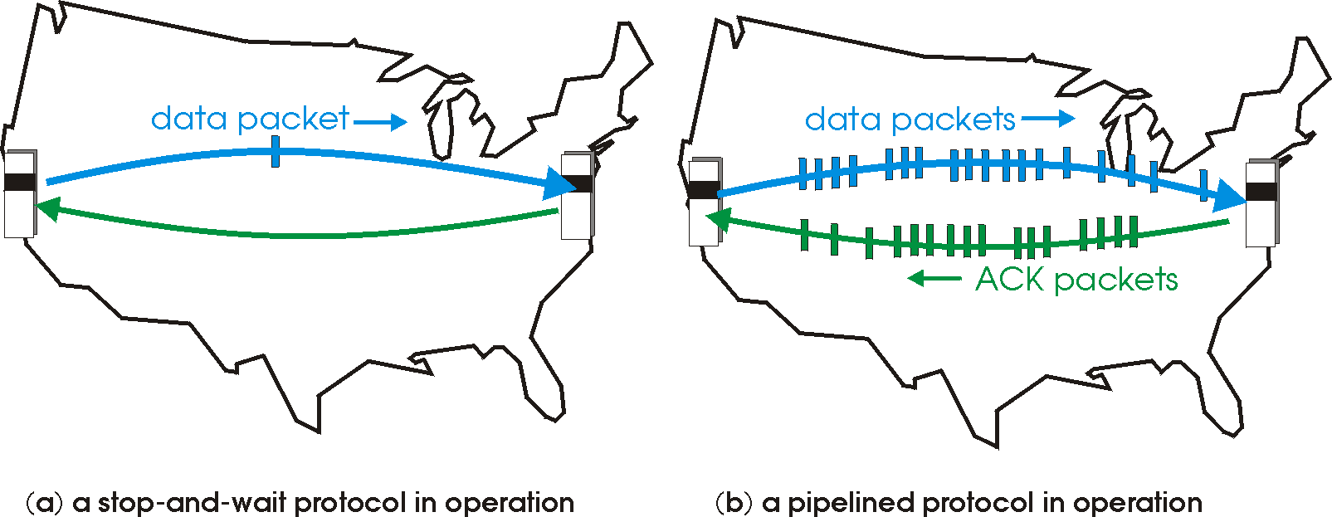

Pipelined protocols
pipelining: sender allows multiple, “in-flight”, yet-to-be-acknowledged pkts
  range of sequence numbers must be increased
  buffering at sender and/or receiver
two generic forms of pipelined protocols: go-Back-N, selective repeat

Slide 26
Pipelining: increased utilization
sender
receiver
first packet bit transmitted, t = 0
last bit transmitted, t = L / R
first packet bit arrives
RTT
last packet bit arrives, send ACK
last bit of 2nd packet arrives, send ACK
last bit of 3rd packet arrives, send ACK
ACK arrives, send next
packet, t = RTT + L / R
3-packet pipelining increases
utilization by a factor of 3!

Slide 27
Pipelined protocols: overview
Go-back-N:
sender can have up to N unacked packets in pipeline
receiver only sends cumulative ack
  doesn’t ack packet if there’s a gap
sender has timer for oldest unacked packet
  when timer expires, retransmit all unacked packets
Selective Repeat:
sender can have up to N unack’ed packets in pipeline
rcvr sends individual ack for each packet
sender maintains timer for each unacked packet
  when timer expires, retransmit only that unacked packet

Slide 28
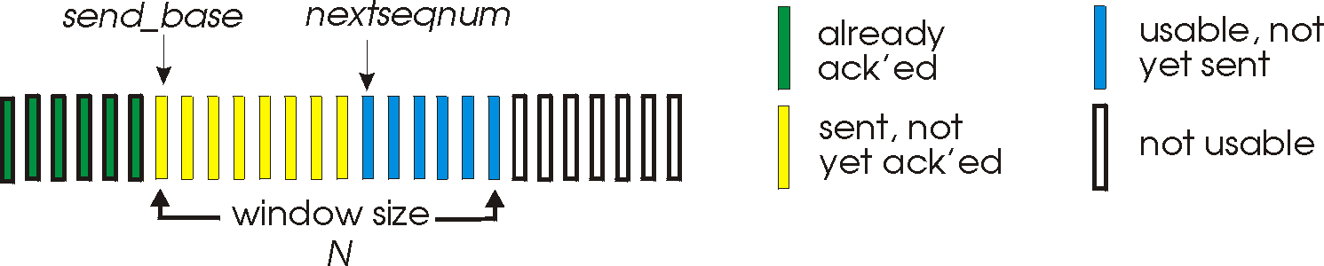
Go-Back-N: sender
k-bit seq # in pkt header
“window” of up to N, consecutive unack’ed pkts allowed
ACK(n): ACKs all pkts up to, including seq # n - “cumulative ACK”
  may receive duplicate ACKs (see receiver)
timer for oldest in-flight pkt
timeout(n): retransmit packet n and all higher seq # pkts in window

Slide 29
GBN: sender extended FSM
rdt_send(data)
if (nextseqnum < base+N) {
sndpkt[nextseqnum] = make_pkt(nextseqnum,data,chksum)
udt_send(sndpkt[nextseqnum])
if (base == nextseqnum)
start_timer
nextseqnum++
}
else
refuse_data(data)
Λ
base=1
nextseqnum=1
timeout
Wait
start_timer
udt_send(sndpkt[base])
udt_send(sndpkt[base+1])
…
udt_send(sndpkt[nextseqnum-1])
rdt_rcv(rcvpkt)
&& corrupt(rcvpkt)
rdt_rcv(rcvpkt) &&
notcorrupt(rcvpkt)
base = getacknum(rcvpkt)+1
If (base == nextseqnum)
stop_timer
else
start_timer

Slide 30
GBN: receiver extended FSM
default
udt_send(sndpkt)
rdt_rcv(rcvpkt)
&& notcurrupt(rcvpkt)
&& hasseqnum(rcvpkt,expectedseqnum)
Λ
Wait
extract(rcvpkt,data)
deliver_data(data)
sndpkt = make_pkt(expectedseqnum,ACK,chksum)
udt_send(sndpkt)
expectedseqnum++
expectedseqnum=1
sndpkt =
make_pkt(expectedseqnum,ACK,chksum)
ACK-only: always send ACK for correctly-received pkt with highest in-order seq #
  may generate duplicate ACKs
  need only remember expectedseqnum
out-of-order pkt:
  discard (don’t buffer): no receiver buffering!
  re-ACK pkt with highest in-order seq #

Slide 31
GBN in action
sender window (N=4)
sender
receiver
0 1 2 3 4 5 6 7 8
send pkt0
send pkt1
send pkt2
send pkt3
(wait)
0 1 2 3 4 5 6 7 8
receive pkt0, send ack0
receive pkt1, send ack1
receive pkt3, discard,
(re)send ack1
0 1 2 3 4 5 6 7 8
X
0 1 2 3 4 5 6 7 8
loss
0 1 2 3 4 5 6 7 8
rcv ack0, send pkt4
rcv ack1, send pkt5
0 1 2 3 4 5 6 7 8
receive pkt4, discard,
(re)send ack1
ignore duplicate ACK
receive pkt5, discard,
(re)send ack1
pkt 2 timeout
0 1 2 3 4 5 6 7 8
send pkt2
send pkt3
send pkt4
send pkt5
0 1 2 3 4 5 6 7 8
0 1 2 3 4 5 6 7 8
rcv pkt2, deliver, send ack2
rcv pkt3, deliver, send ack3
rcv pkt4, deliver, send ack4
rcv pkt5, deliver, send ack5
0 1 2 3 4 5 6 7 8

Slide 32
Selective repeat
receiver individually acknowledges all correctly received pkts
  buffers pkts, as needed, for eventual in-order delivery to upper layer
sender only resends pkts for which ACK not received
  sender timer for each unACKed pkt
sender window
  N consecutive seq #’s
  limits seq #s of sent, unACKed pkts

Slide 33
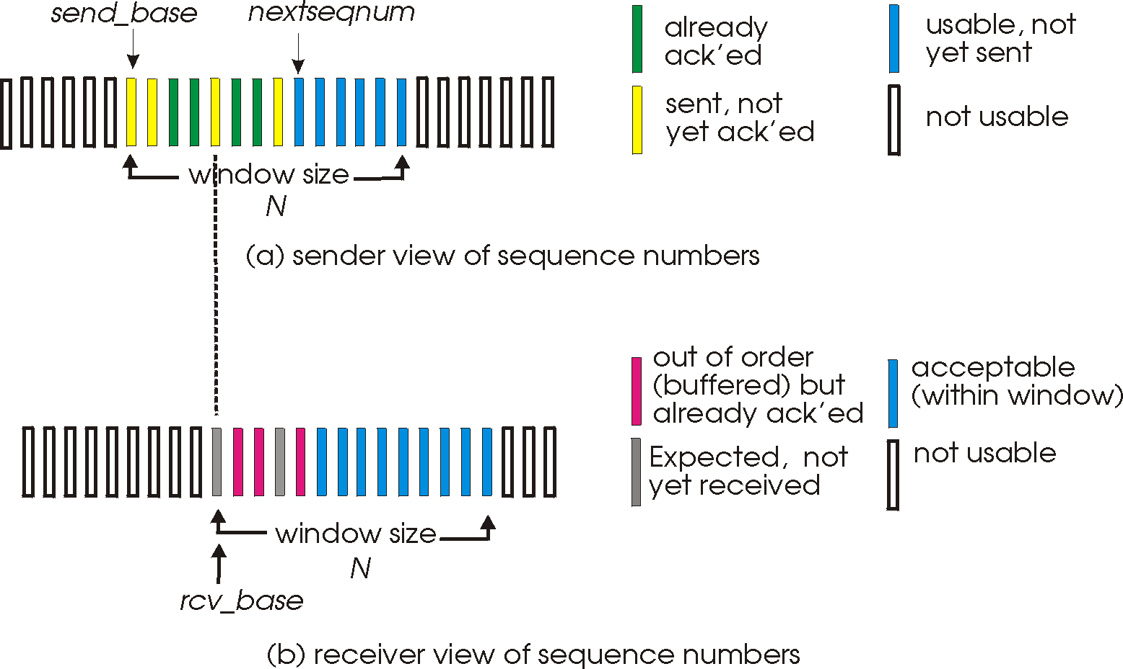
Selective repeat: sender, receiver windows

Slide 34
Selective repeat
sender
receiver
data from above:
if next available seq # in window, send pkt
timeout(n):
resend pkt n, restart timer
ACK(n) in [sendbase,sendbase+N]:
mark pkt n as received
if n smallest unACKed pkt, advance window base to next unACKed seq #
pkt n in [rcvbase, rcvbase+N-1]
send ACK(n)
out-of-order: buffer
in-order: deliver (also deliver buffered, in-order pkts), advance window to next not-yet-received pkt
pkt n in [rcvbase-N,rcvbase-1]
ACK(n)
otherwise:
ignore

Slide 35
Selective repeat in action
sender window (N=4)
sender
receiver
0 1 2 3 4 5 6 7 8
send pkt0
send pkt1
send pkt2
send pkt3
(wait)
0 1 2 3 4 5 6 7 8
receive pkt0, send ack0
receive pkt1, send ack1
receive pkt3, buffer,
send ack3
0 1 2 3 4 5 6 7 8
X
0 1 2 3 4 5 6 7 8
loss
0 1 2 3 4 5 6 7 8
rcv ack0, send pkt4
rcv ack1, send pkt5
0 1 2 3 4 5 6 7 8
receive pkt4, buffer,
send ack4
record ack3 arrived
receive pkt5, buffer,
send ack5
pkt 2 timeout
0 1 2 3 4 5 6 7 8
send pkt2
0 1 2 3 4 5 6 7 8
record ack4 arrived
0 1 2 3 4 5 6 7 8
rcv pkt2; deliver pkt2,
pkt3, pkt4, pkt5; send ack2
record ack5 arrived
0 1 2 3 4 5 6 7 8
Q: what happens when ack2 arrives?

Slide 36

Selective repeat: dilemma
sender window
(after receipt)
receiver window
(after receipt)
0 1 2 3 0 1 2
pkt0
0 1 2 3 0 1 2
pkt1
0 1 2 3 0 1 2
example:
seq #’s: 0, 1, 2, 3
window size=3
0 1 2 3 0 1 2
pkt2
0 1 2 3 0 1 2
0 1 2 3 0 1 2
0 1 2 3 0 1 2
pkt3
X
0 1 2 3 0 1 2
pkt0
will accept packet
with seq number 0
receiver sees no difference in two scenarios!
duplicate data accepted as new in (b)
Q: what relationship between seq # size and window size to avoid problem in (b)?
(a) no problem
receiver can’t see sender side.
receiver behavior identical in both cases!
something’s (very) wrong!
0 1 2 3 0 1 2
pkt0
0 1 2 3 0 1 2
pkt1
0 1 2 3 0 1 2
0 1 2 3 0 1 2
pkt2
0 1 2 3 0 1 2
X
0 1 2 3 0 1 2
X
timeout
retransmit pkt0
X
0 1 2 3 0 1 2
pkt0
will accept packet
with seq number 0
(b) oops!

